Slide 1


Restful ABAP Programming

Slide 2


Look At the BIG Picture

Slide 3
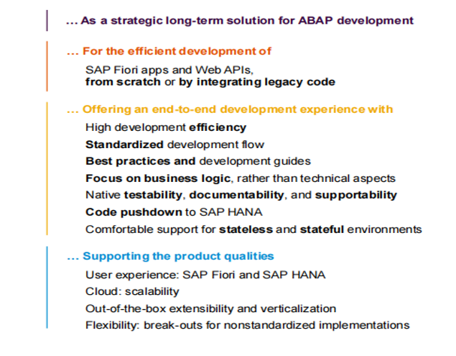
ABAP RESTful Application Programming Model (RAP) – The mission
Provide a programming model …

Slide 4
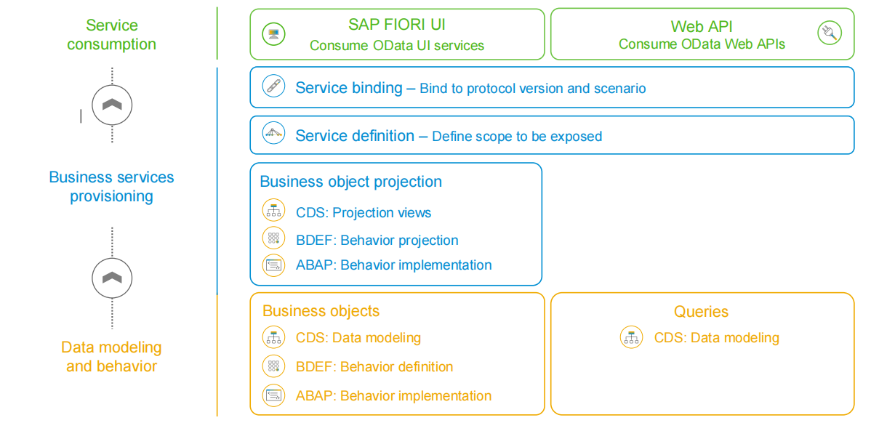
The Big Picture

Slide 5
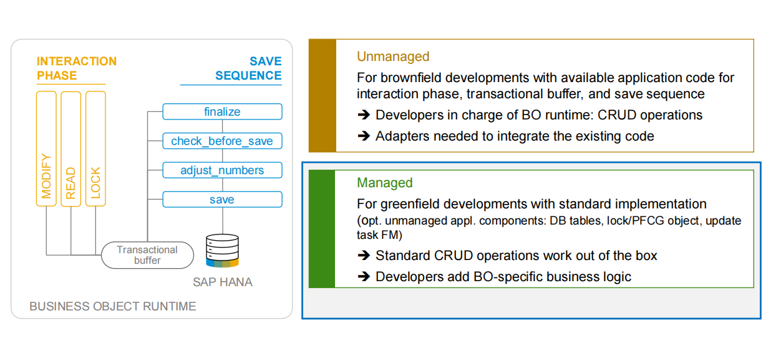
Business Object Runtime Implementation Types

Slide 6
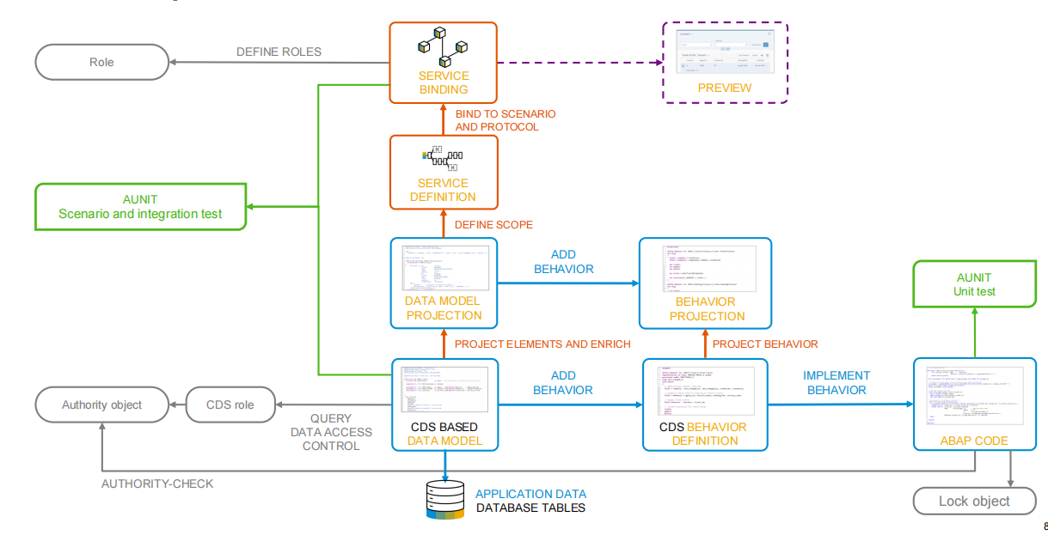
The Development Flow

Slide 7
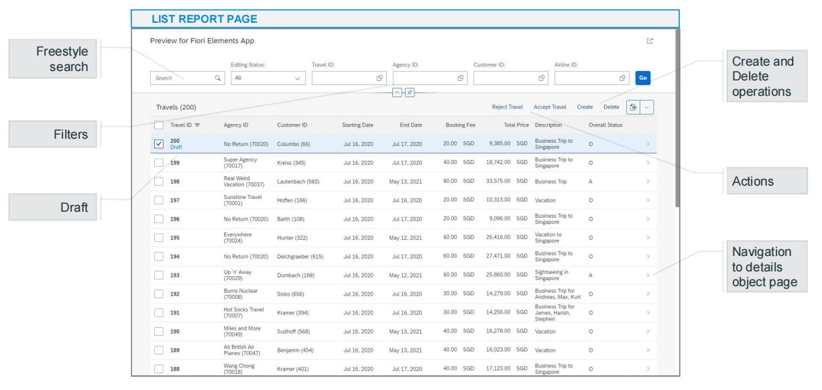
Build a SAP Fiori App with Transactional, Filtering and Search Capabilities

Slide 8
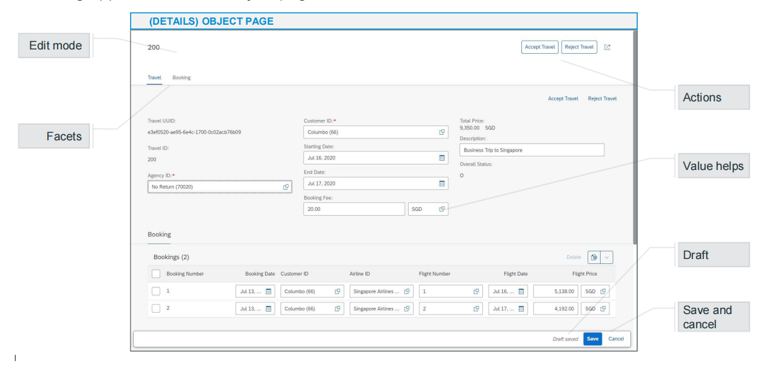
Build a SAP Fiori App with Transactional, Filtering and Search Capabilities

Slide 9
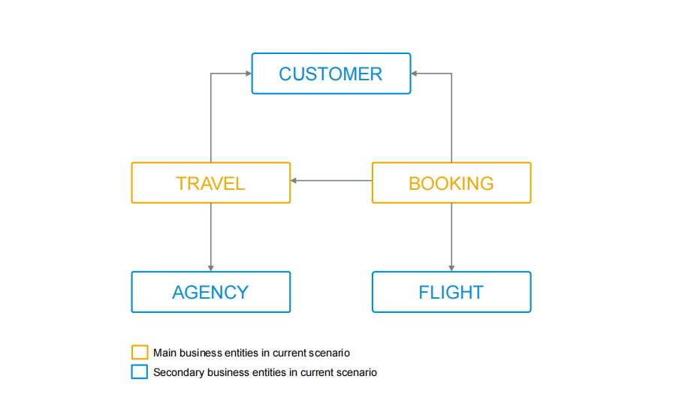
Underlying Simplified Flight (reloaded) Data Model

Slide 10
Underlying Simplified Flight (reloaded) Data Model

Slide 11
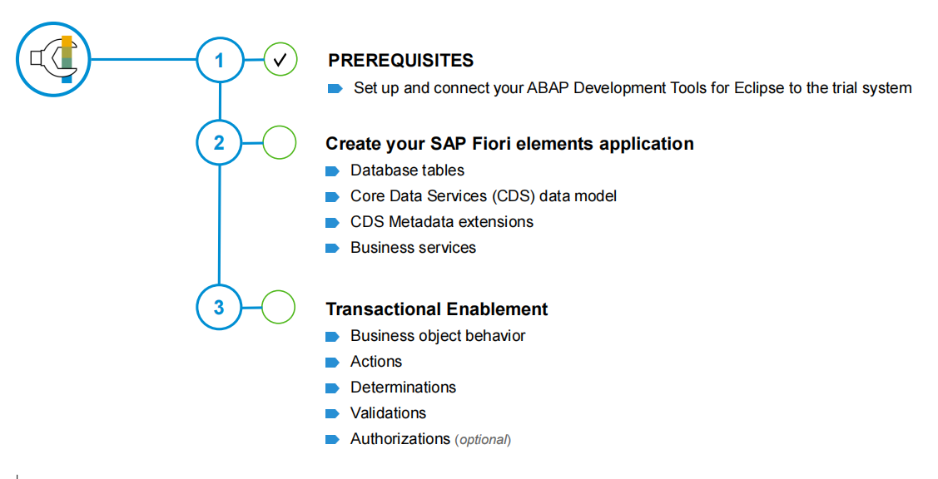

Let’s do Excercise :
Feel free to ask questions
and to get support if needed !

Slide 12
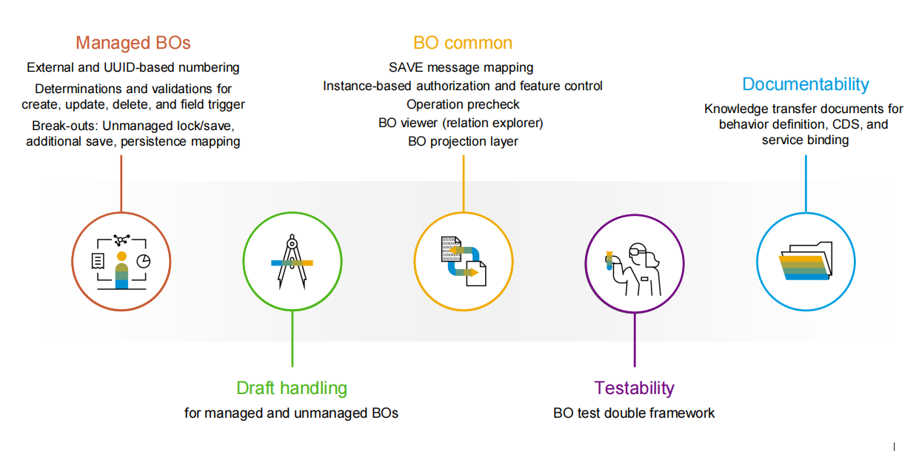
Few More Additions :

Slide 13
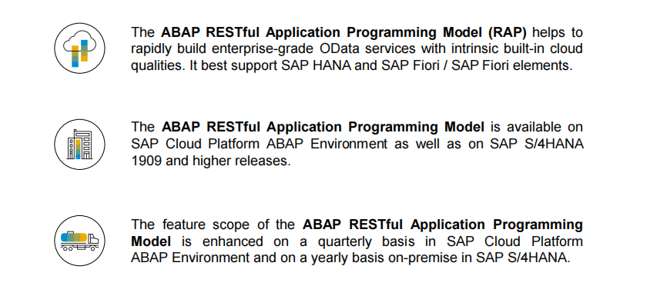
Key Takeaways :

Slide 14
Some Helpful Links :
Building a transactional Fiori app using the unmanaged runtime implementation
Building a transactional Fiori app using the managed runtime implementation
Development Guides from the SAP documentation (Entry Point)
Downloading the ABAP Flight Reference Scenario (on-premise flavor)
Developing an OData service for simple list reporting
Developing read-only list reporting apps
Developing new managed transactional apps (managed Implementation)
Developing new transaction apps with draft capabilities (managed Implementation)
Developing new unmanaged transactional apps based on existing application logic ( unmanaged Implementation )
Developing a Web API

Slide 15
Further Recordings:
In the following videos, different system demonstrations on the greenfield application development with the managed runtime implementation type are shown.
SAP TechEd 2019, Las Vegas | CAA103 – Get the Big Picture of the ABAP RESTful Programming Model
SAP TechEd 2019, Barcelona | CAA103 – Get the Big Picture of the ABAP RESTful Programming Model
In the following videos, different system demonstrations on the brownfield application development with the unmanaged runtime implementation type are shown.
SAP TechEd 20188 | CNA215 – Get the Big Picture of the ABAP RESTful Programming Model
SAP TechEd 2018 | CNA216 – Technical Deep Dive into the ABAP RESTful Programming Model

Slide 16
Major updates in the ABAP RESTful application programming model
Numbering
Unmanaged locks
Unmanaged save
Additional save
Draft support
Feature control
Precheck
Relation explorer
Knowledge transfer document editor

